Slide 1
Programming JAVA {
Hiveed.java
OOPs;
/* Here is where your journey for your dream begins */
}
JAVA Programming

Slide 2
Hiveed.java
What is oops :
OOPS- Stands for Object Oriented Programming Structure.
Procedural programming focuses on methods operating on data, whereas object-oriented programming involves creating objects with both data and methods.
Advantages :
OOPS is faster and easier to execute clear structure for the programs
OOPS makes the code easier to maintain, modify and debug to create full reusable applications with less code and shorter development time
JAVA Programming

Slide 3
Hiveed.java
Why we need object :
TO represent the real world entity in software field.
To create the Object we need blueprint
How to create the object :
new is a Keyword.
It is used to create an object
And it return address of the object. A variable is stored the address of object is called non-primitive datatypes.
JAVA Programming

Slide 4
Hiveed.java
Pillars of OOPS :
Encapsulation.
inheritance
polymorphism
Abstraction and interface/multiple inheritance
JAVA Programming

Slide 5
Hiveed.java
Encapsulation :
The process of binding states and behaviour togeather is called the encapsulation.
or
The process of wrapping the states and behaviour of a class in a single unit is called the encapsulation.
In java by default it will support the encapsulation because inside class we are creating a variables and methods.
Advantages :
Data security and data validation.
JAVA Programming

Slide 6
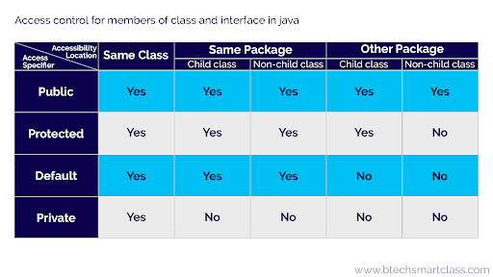
Hiveed.java
Access modifiers :
Access modifiers are used to achive the encapsulation.
JAVA Programming

Slide 7
Hiveed.java
Package is nothing but a Collection java Class into a Single folder.
Access modifiers :
Java bean class is an example for encapsulation.
What is Java Bean Class :
The Class must be public access specifier.
The attributes of the class must be private.
Class should contain public getter and setter method.
JAVA Programming

Slide 8
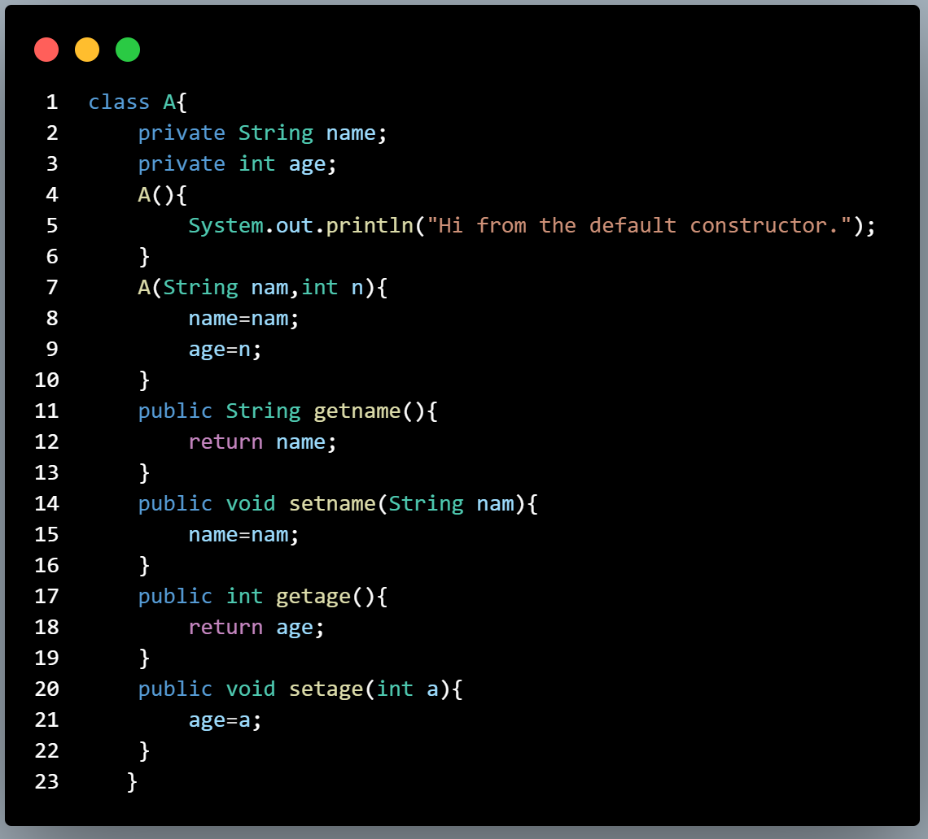
Hiveed.java
JAVA Bean-Class :
Private Attributes
Getter and Setter method
JAVA Programming

Slide 9
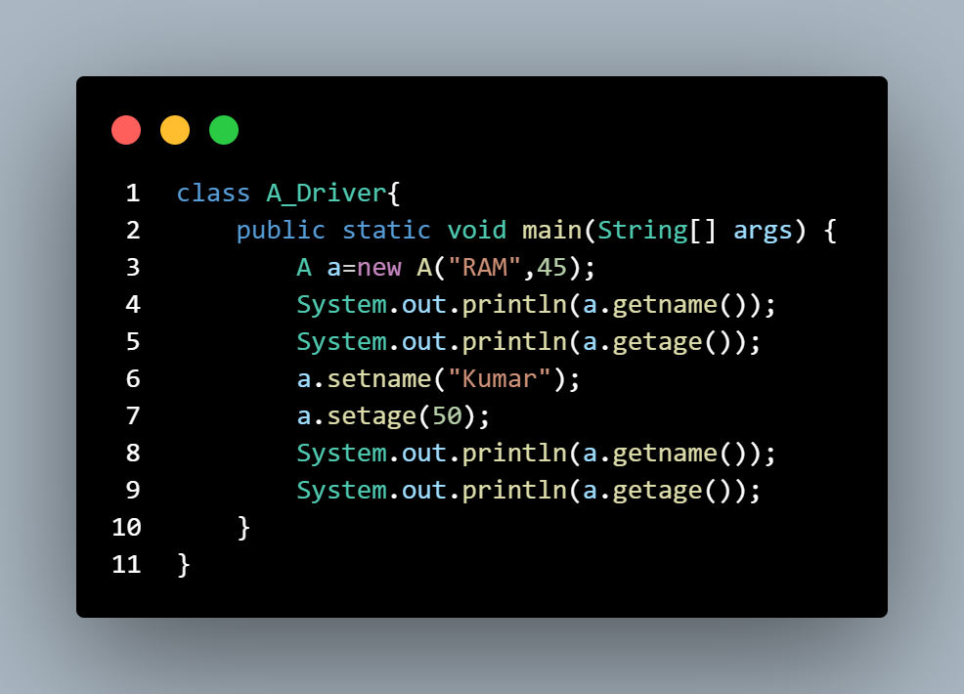
Hiveed.java
JAVA Bean-Class :
JAVA Programming

